Slide 1
Week 5 Project (IMS)
By James Williams

Slide 2
About me
BEng in Electronic & Electrical Engineering from Loughborough University (2017)
Started at QA in January, my first programming experience was about 4 weeks ago!
Now in week 5 at the training academy as a trainee software development consultant.

Slide 3
Project Specification
Tasked with creating an IMS with full CRUD functionality on Customers, Items and Orders.
Do this using all of the knowledge I have gained over the last 5 weeks.
The IMS requires implementation of various different learning pathways, including:
Java
MySQL
Agile fundamentals and Project Management
Cloud virtual machines
Continuous Integration
Automated Testing

Slide 4
Analysis and design
To aid me in designing the project, I used several tools such as a Kanban board, an ERD and a UML diagram that evolved over time.
My code was analysed using SonarQube.
I also conducted a Risk Assessment during the project.

Slide 5
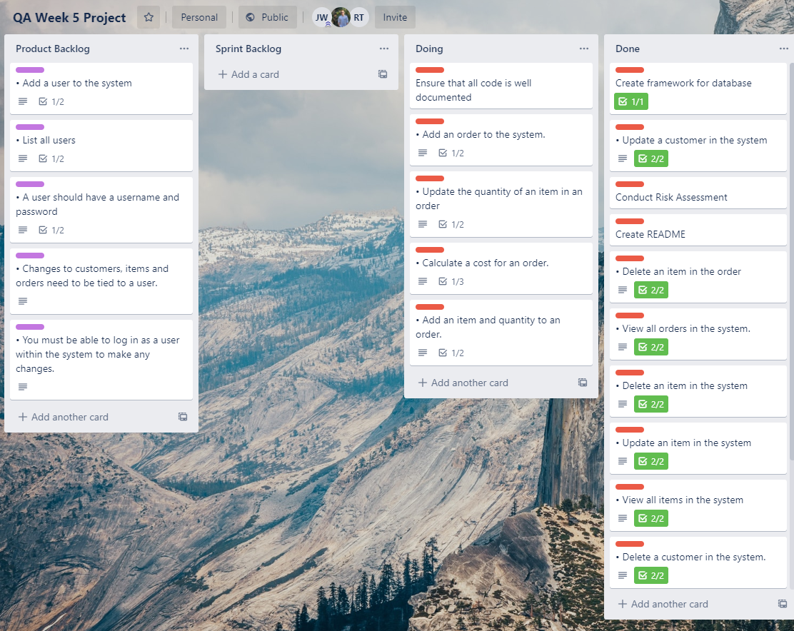
Trello Board
This Trello board was used to help me track project progress as I completed each element involved.

Slide 6
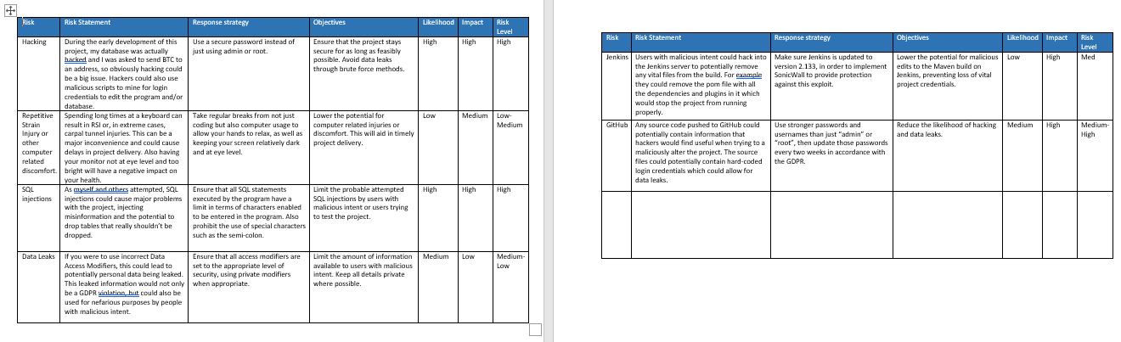
Risk Assessment
This Risk Assessment allowed me to keep track of any threats to project completion, as well as any risks that may arise during project work.

Slide 7
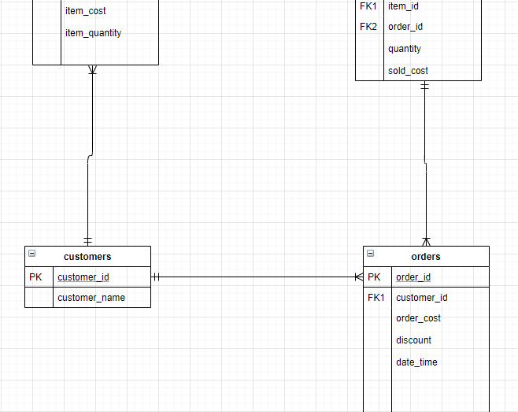
Entity Relationship Diagram
This ERD allows the user to see a basic overview of the tables and attributes in my database.

Slide 8
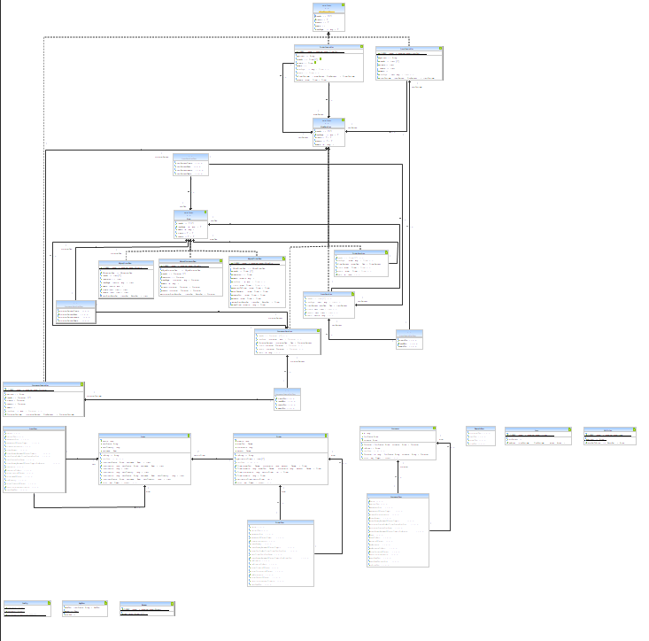
UML Diagram
This UML Diagram allows the user to see how all my classes interact with each other.

Slide 9
Coding
During the design and implementation of this project, I used OOP and SOLID principles to help design my system.
Single Responsibility – each of my DAO objects only access the database once.
Open-closed – each of my objects are closed to modification, but can be implemented by other methods.
Liskov’s substitution – my controller classes pass down a subclass of my interfaces and that works the same as passing down the interface itself.
Interface segregation – all interfaces implemented by my classes are used.
Dependency inversion – all child classes depend on their parents, not vice-versa.

Slide 10
Testing
My code is run through SonarQube to check code quality and to help me see any issues in the source code.
When building using Maven, all tests are run and the build fails if any of the tests fail.
I tested using Junit and Mockito.

Slide 11
Automation
My project is automated using the Jenkins CI server, which is hosted through a VM on my GCP account.
This is used to build my project whenever a new commit is pushed to GitHub.

Slide 12
What I learned
For my next project, I intend to:
Plan the project better
Set out more rigorous time frames
Work on multiple elements of the project at once
Spend more time focusing on my problems
Use a more test-driven approach

